Slide 1
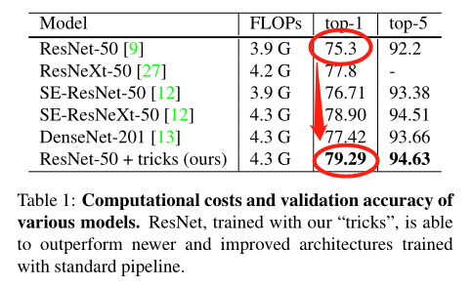
Bag of Tricks for Image Classification with Convolutional Neural Networks
Tong He Zhi Zhang Hang Zhang Zhongyue Zhang Junyuan Xie Mu Li
CVPR 2019

Slide 2
Contents
Abstract
Introduction
Training Procedures（训练过程）
Efficient Training（高效的训练）
Model Tweaks（模型调整）
Training Refinements（训练改进）
Transfer Learning（迁移学习）
Conclusion

Slide 3
Abstract
Much of the recent progress made in image classification research can be credited to training procedure refinements, such as changes in data augmentations and optimization methods
In this paper, we will examine a collection of such refinements and empirically evaluate their impact on the final model accuracy through ablation study.
By combining these refinements together, we are able to improve various CNN models significantly.

Slide 4
1. Introduction
Unlike architectural advancements, training procedure refinements, including changes in loss functions, data preprocessing, and optimization methods received relatively less attention.
In this paper, a collection of training procedure and model architecture refinements that improve model accuracy but barely change computational complexity will be examine.
Many of them are minor “tricks” like modifying the stride size of a particular convolution layer or adjusting learning rate schedule. Collectively, however, they make a big difference.

Slide 5
1. Introduction
Paper Outline.
set up a baseline training procedure
discuss several tricks that are useful for efficient training on new hardware
review three minor model architecture tweak for ResNet and propose a new one
Four additional training procedure refinements are then discussed
study if these more accurate models can help transfer learning

Slide 6
2. Training Procedures

Slide 7
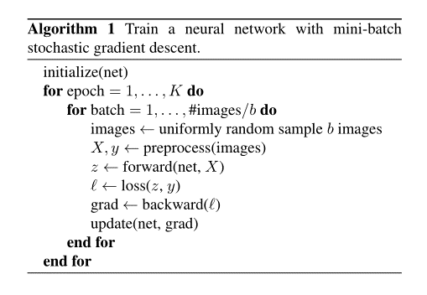

Slide 8
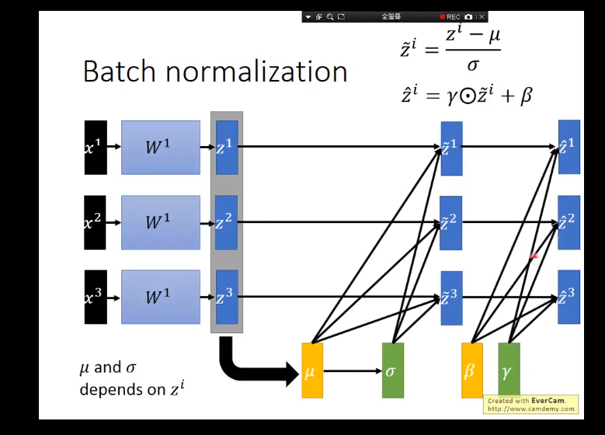
2.1 Baseline Training Procedure
Baseline architecture: Resnet-50
Weights initialization: Xavier algorithm
Bias initialization: all zeros
Batch Normalization layers: (γ,β)=(1,0)
Optimizer: Nesterov Accelerated Gradient (NAG)
Each model trained for 120 epochs, 8 V100 GPUs, batch size of 256
Learning rate: initialized to 0.1, divided by 10 at the 30th, 60th, and 90th epochs.

Slide 9
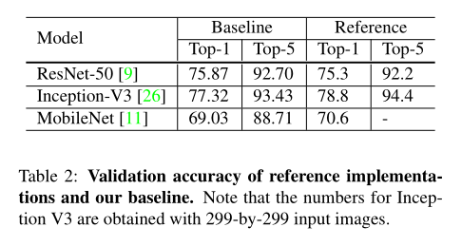
2.1 Baseline Training Procedure
Data: ISLVRC2012 [23] dataset, which has 1.3 million images for training and 1000 classes.

Slide 10
3. Efficient Training

Slide 11
3. Efficient Training
3.1. Large-batch training
Linear scaling learning rate
Learning rate warmup
Zero γ
No bias decay.
3.2. Low-precision training
3.3. Experiment Results

Slide 12
3.1. Large-batch training
Mini-batch SGD groups multiple samples to a mini-batch to increase parallelism and decrease communication costs.
Using large batch size, however, may slow down the training progress.
For the same number of epochs, training with a large batch size results in a model with degraded validation accuracy compared to the ones trained with smaller batch sizes.
In the following paragraphs, we will examine four heuristics that help scale the batch size up for single machine training.

Slide 13
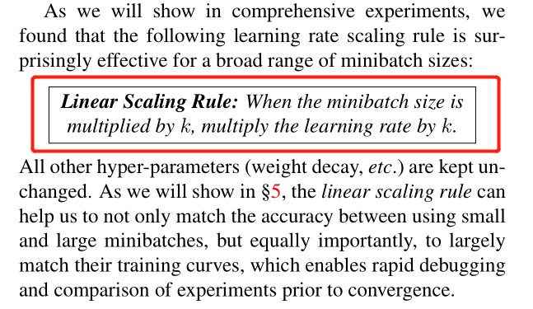
3.1. Large-batch training
Linear scaling learning rate
Initial learning rate: 0.1
Batch size: 256
Initial learning rate: 0.1×b/256
Batch size: b
Accurate, large minibatch SGD: training imagenet in 1 hour
https://arxiv.org/abs/1706.02677

Slide 14
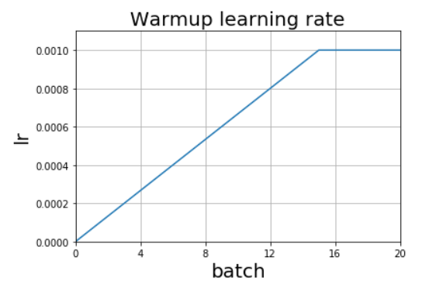
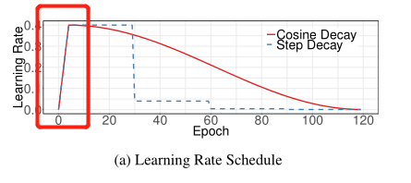
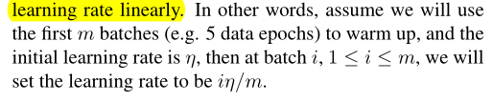
3.1. Large-batch training
Learning rate warmup
Accurate, large minibatch SGD: training imagenet in 1 hour
https://arxiv.org/abs/1706.02677
https://www.dlology.com/blog/bag-of-tricks-for-image-classification-with-convolutional-neural-networks-in-keras
神经网络中 warmup 策略为什么有效：https://www.zhihu.com/question/338066667

Slide 15
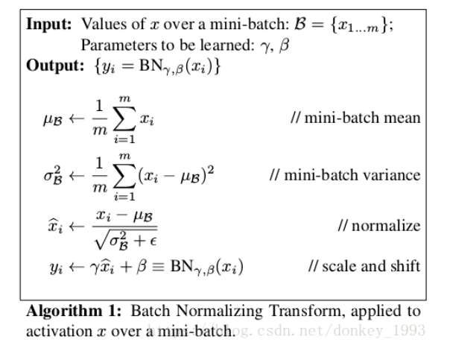
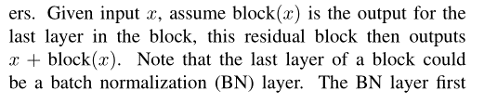
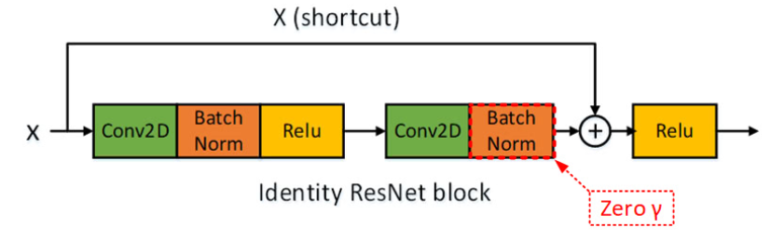
3.1. Large-batch training
Zero γ
All residual blocks just return their inputs, mimics network that has less number of layers and is easier to train at the initial stage.
https://blog.csdn.net/donkey_1993/article/details/81871132
https://www.dlology.com/blog/bag-of-tricks-for-image-classification-with-convolutional-neural-networks-in-keras/

Slide 16
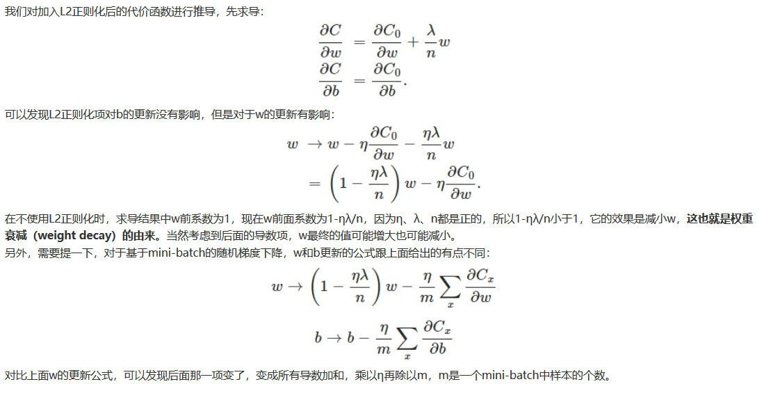
3.1. Large-batch training
No bias decay.
L2 regularization: to all parameters, often.
No bias decay
Only apply the regularization to weights
Not for biases, γ and β in BN layers
Highly scalable deep learning training system with mixed-precision: Training imagenet in four minutes.
https://arxiv.org/pdf/1807.11205.pdf
https://blog.csdn.net/program_developer/article/details/80867468

Slide 17
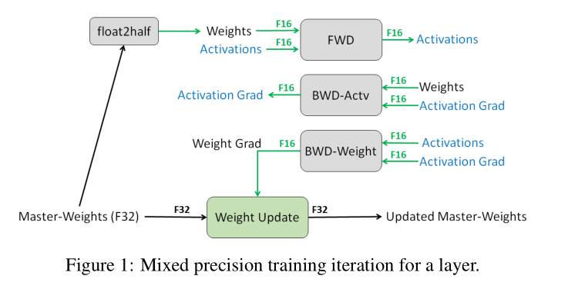
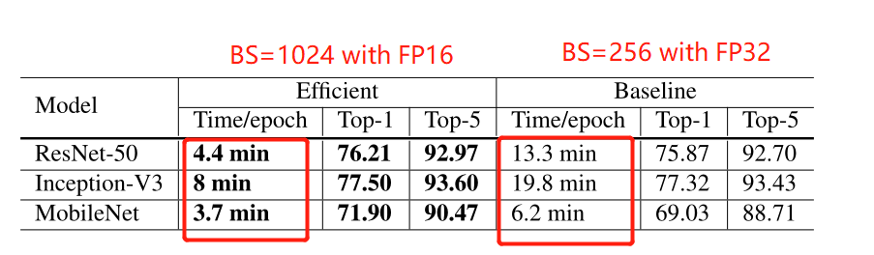
3.2. Low-precision training
Weights, activations,
Gradients:FP16
Master weights updated
During optimizer step: FP32
Mixed precision training
https://arxiv.org/pdf/1710.03740.pdf

Slide 18
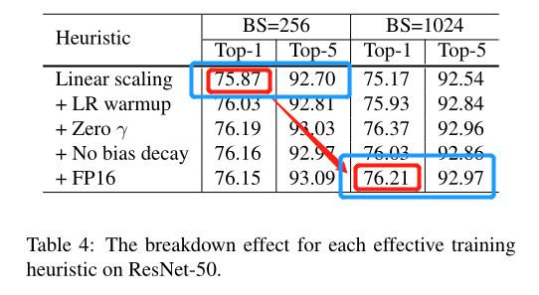
3.3. Experiment Results

Slide 19
4. Model Tweaks

Slide 20
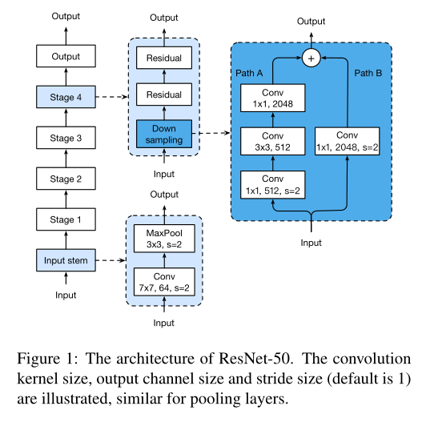
4.1. ResNet Architecture
Deep residual learning for image recognition.
https://arxiv.org/pdf/1512.03385.pdf

Slide 21
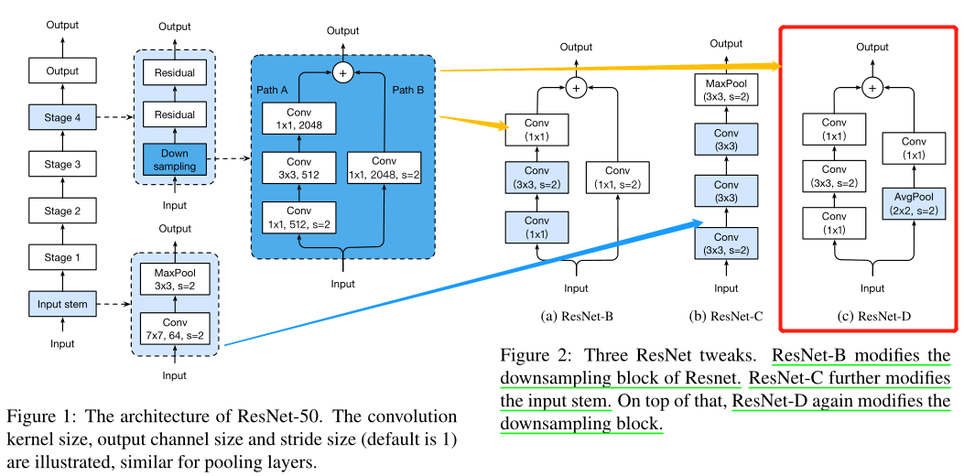
4.1. ResNet Tweaks
Minor Adjustment to the ResNet-50 Network

Slide 22
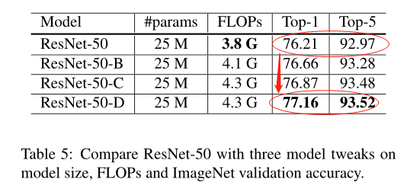
4.3. Experiment Results

Slide 23
5. Training Refinements

Slide 24
5. Training Refinements
5.1. Cosine Learning Rate Decay
5.2. Label Smoothing
5.3. Knowledge Distillation
5.4. Mixup Training

Slide 25
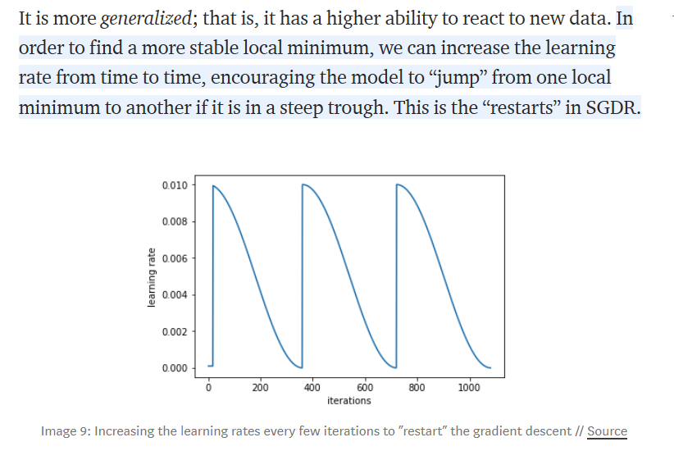
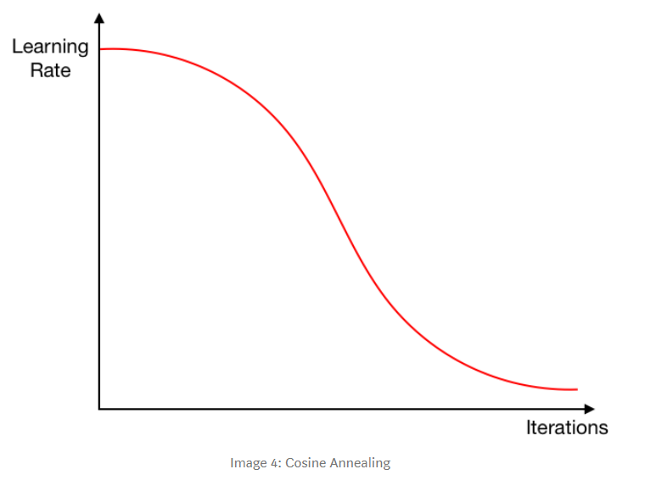
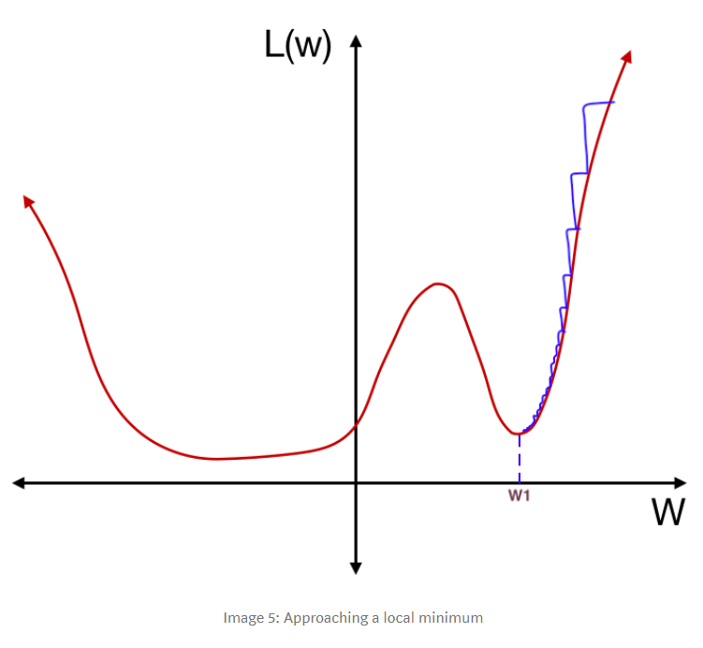
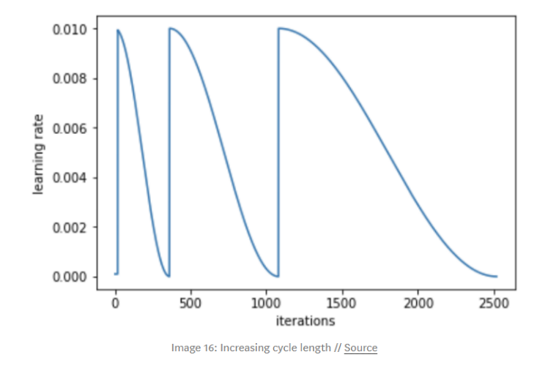
5.1. Cosine Learning Rate Decay
SGDR: stochastic gradient descent with restarts
https://arxiv.org/pdf/1608.03983.pdf
https://towardsdatascience.com/https-medium-com-reina-wang-tw-stochastic-gradient-descent-with-restarts-5f511975163

Slide 26
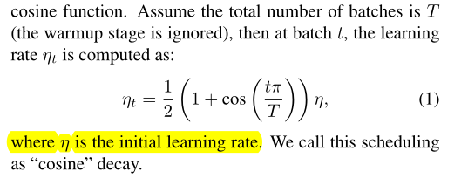
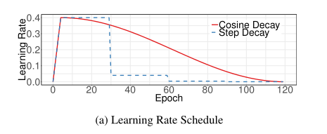
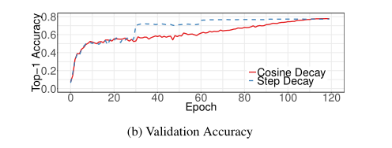
5.1. Cosine Learning Rate Decay

Slide 27



5.2. Label Smoothing
q = softmax(z) the negative cross entropy loss
One hot: (0, 1, 0, 0, 0)
Smoothed: (0.01, 0.96, 0.01, 0.01,0.01)
Prevent overfitting!
Rethinking the inception architecture for computer vision
https://arxiv.org/abs/1512.00567

Slide 28
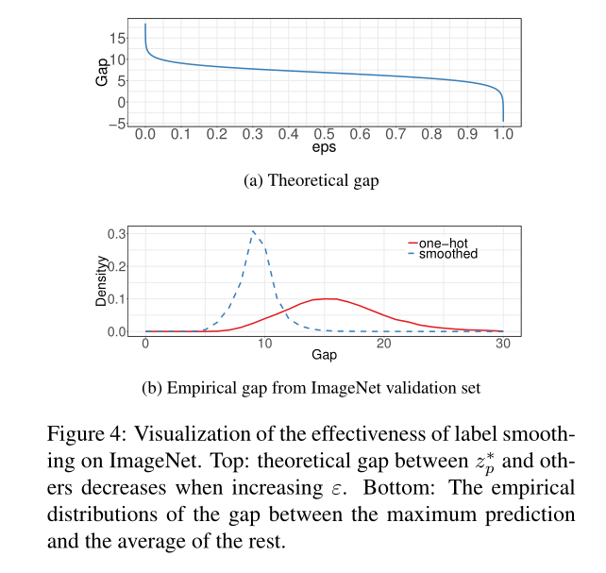
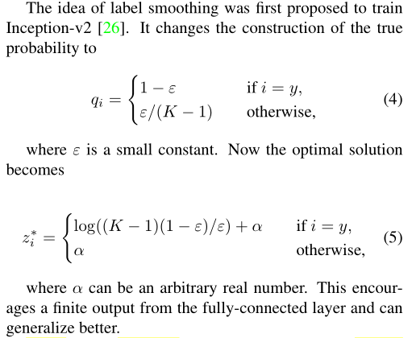
5.2. Label Smoothing

Slide 29
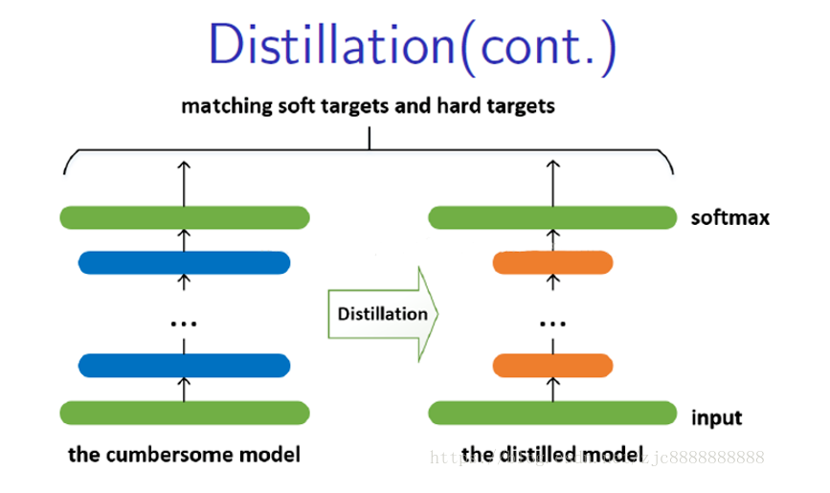
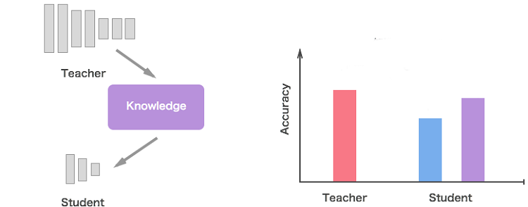
5.3. Knowledge Distillation
Distilling the knowledge in a neural network
https://arxiv.org/abs/1503.02531
https://software.intel.com/content/www/us/en/develop/articles/knowledge-distillation-with-keras.html

Slide 30
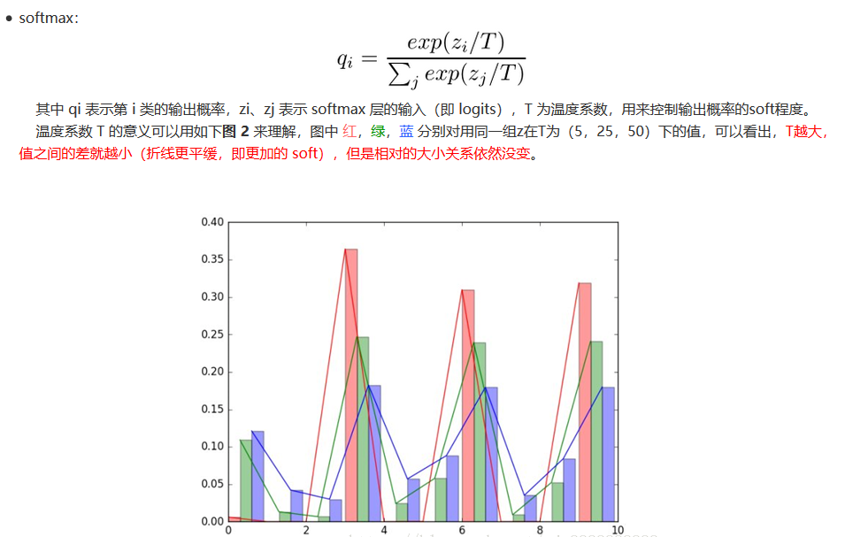
5.3. Knowledge Distillation
https://medium.com/analytics-vidhya/knowledge-distillation-dark-knowledge-of-neural-network-9c1dfb418e6a

Slide 31
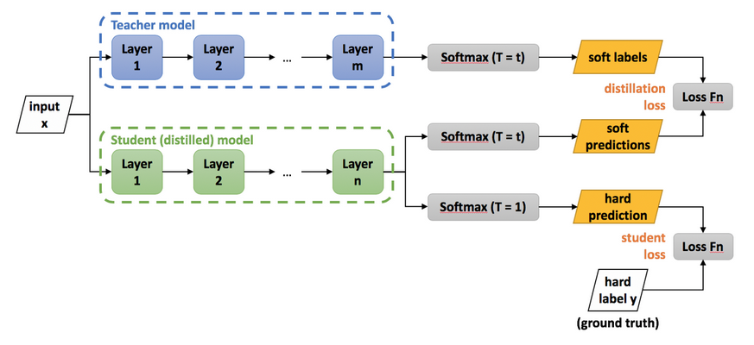

5.3. Knowledge Distillation

Slide 32
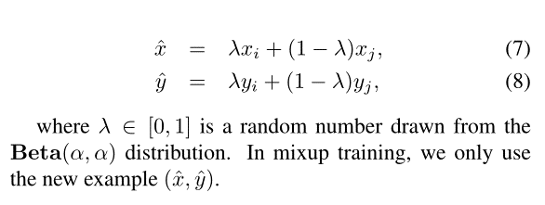
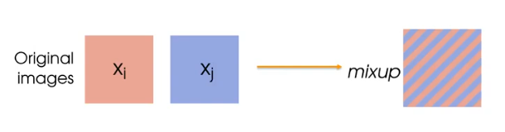
5.4. Mixup Training
Mixup: Beyond empirical risk minimization
https://arxiv.org/abs/1710.09412

Slide 33
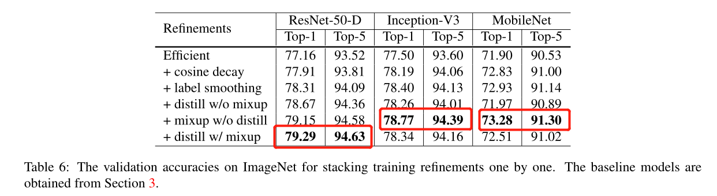
5.5. Experiment Results

Slide 34
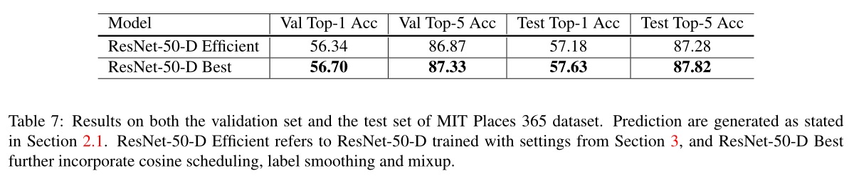
5.5. Experiment Results

Slide 35
6. Transfer Learning

Slide 36
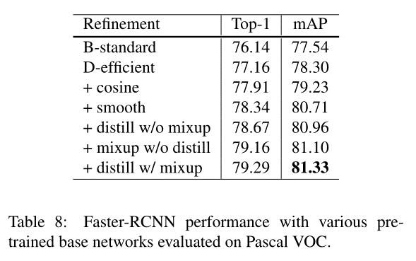
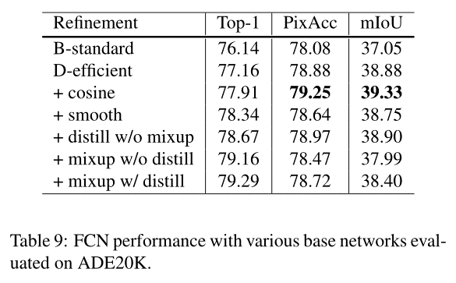
6. Transfer Learning

Slide 37
7. Conclusion

Slide 38
7. Conclusion
Survey a dozen tricks to train deep convolutional neural networks to improve model accuracy.
Tricks: Model Tweaks, data preprocessing, loss function, learning rate schedule
Empirical results on ResNet-50, Inception-V3 and MobileNet indicate that these tricks improve model accuracy consistently
Stacking all of them together leads to a significantly higher accuracy
Strong advantages in transfer learning, which improve both object detection and semantic segmentation

